Slide 1

SQL Notes
Abraham

Slide 2
What is RDBMS?
RDBMS stands for Relational Database Management System. RDBMS is the basis for SQL, and for all modern database systems like MS SQL Server, IBM DB2, Oracle, MySQL, and Microsoft Access.
A Relational database management system (RDBMS) is a database management system (DBMS) that is based on the relational model as introduced by E. F. Codd in 1970.
What is a Table?
The data in an RDBMS is stored in database objects known as tables. This table is basically a collection of related data entries and it consists of numerous columns and rows.
Remember, a table is the most common and simplest form of data storage in a relational database. Following is an example of a EMPLOYEES table which stores customer's ID, Name, Age, Salary, City and Country

Slide 3
What is a Field?
Every table is broken up into smaller entities called fields. A field is a column in a table that is designed to maintain specific information about every record in the table.
For example, our EMPLOYEES table consists of different fields like ID, Name, Age, Salary, City and Country.
What is a Record or a Row?
A record is also called as a row of data is each individual entry that exists in a table. For example, there are 7 records in the above EMPLOYEES table.

Slide 4
What is a Column?
A column is a vertical entity in a table that contains all information associated with a specific field in a table.
For example, our EMPLOYEES table have different columns to represent ID, Name, Age, Salary, City and Country.
What is a NULL Value?
A NULL value in a table is a value in a field that appears to be blank, which means a field with a NULL value is a field with no value.
It is very important to understand that a NULL value is different than a zero value or a field that contains spaces. A field with a NULL value is the one that has been left blank during a record creation. Following table has three records where first record has NULL value for the salary and second record has a zero value for the salary.

Slide 5
SQL Databases
Relational databases are used to store and manage the data objects that are related to one another, i.e. the process of handling data in a relational database is done based on a relational model. This relational model is an approach to manage data in a structured way (using tables). A system used to manage these relational databases is known as Relational Database Management System (RDBMS).
There are many popular RDBMS available to work with. Some of the most popular RDBMS are listed below −
MySQL
MS SQL Server
ORACLE
MS ACCESS
PostgreSQL
SQLite

Slide 6
What is SQL Syntax?
SQL is followed by a unique set of rules and guidelines called Syntax. This tutorial gives you a quick start with SQL by listing all the basic SQL Syntax.
All the SQL statements start with any of the keywords like SELECT, INSERT, UPDATE, DELETE, ALTER, DROP, CREATE, USE, SHOW and all the statements end with a semicolon (;).
Case Sensitivity
The most important point to be noted here is that SQL is case insensitive, which means SELECT and Select have same meaning in SQL statements. Whereas, MySQL makes difference in table names. So, if you are working with MySQL, then you need to give table names as they exist in the database.
SQL Table
Let us consider a table with the name EMPLOYEES shown below, and use it as a reference to demonstrate all the SQL Statements on the same.

Slide 7
What are SQL Data types?
An SQL data type refers to the type of data which can be stored in a column of a database table. For example integer data, character data, monetary data, date and time data, binary strings, and so on.
While creating a database table in a database, we need to specify following two attributes to define a table column:
Name of the column
Data type of the column
Types of SQL Data Types
There are three main types of SQL data types available in any RDBMS. They are listed below −
String
Numeric
Date and Time

Slide 8
MySQL - String Data Types
Data type Description
CHAR(size) A fixed length string which can have letters, numbers, and special characters. The size parameter specifies the column length in characters which can vary from from 0 to 255. Default size is 1
VARCHAR(size) A variable length string which can contain letters, numbers, and special characters. The size parameter specifies the maximum string length in characters which can vary from 0 to 65535.
BINARY(size) This is equal to CHAR(), but stores binary byte strings. The size parameter specifies the column length in bytes. Default size is 1
VARBINARY(size) This is equal to VARCHAR(), but stores binary byte strings. The size parameter specifies the maximum column length in bytes.
TINYTEXT This holds a string with a maximum length of 255 characters
TEXT(size) This holds a string with a maximum length of 65,535 bytes
LONGTEXT This holds a string with a maximum length of 4,294,967,295 characters
TINYBLOB This represents a small BLOBs (Binary Large Objects). Max length is 255 bytes
BLOB(size) This represents a BLOBs (Binary Large Objects). Holds up to 65,535 bytes of data

Slide 9
MySQL - Numeric Data Types
Data type Description
INT A normal-sized integer that can be signed or unsigned. If signed, the allowable range is from -2147483648 to 2147483647. If unsigned, the allowable range is from 0 to 4294967295. You can specify a width of up to 11 digits.
TINYINT A very small integer that can be signed or unsigned. If signed, the allowable range is from -128 to 127. If unsigned, the allowable range is from 0 to 255. You can specify a width of up to 4 digits.
SMALLINT A small integer that can be signed or unsigned. If signed, the allowable range is from -32768 to 32767. If unsigned, the allowable range is from 0 to 65535. You can specify a width of up to 5 digits.
MEDIUMINT A medium-sized integer that can be signed or unsigned. If signed, the allowable range is from -8388608 to 8388607. If unsigned, the allowable range is from 0 to 16777215. You can specify a width of up to 9 digits.

Slide 10
MySQL - Date and Time Data Types
Data type Description
DATE A date in YYYY-MM-DD format, between 1000-01-01 and 9999-12-31. For example, December 30th, 1973 would be stored as 1973-12-30.
DATETIME A date and time combination in YYYY-MM-DD HH:MM:SS format, between 1000-01-01 00:00:00 and 9999-12-31 23:59:59. For example, 3:30 in the afternoon on December 30th, 1973 would be stored as 1973-12-30 15:30:00.
TIMESTAMP A timestamp between midnight, January 1st, 1970 and sometime in 2037. This looks like the previous DATETIME format, only without the hyphens between numbers; 3:30 in the afternoon on December 30th, 1973 would be stored as 19731230153000 ( YYYYMMDDHHMMSS ).
TIME Stores the time in a HH:MM:SS format.
YEAR(M) Stores a year in a 2-digit or a 4-digit format. If the length is specified as 2 (for example YEAR(2)), YEAR can be between 1970 to 2069 (70 to 69). If the length is specified as 4, then YEAR can be 1901 to 2155. The default length is 4.

Slide 11
Data type Description
char(n) It holds the character string with the fixed width. Maximum size of this data type is 8000 characters.
varchar(n) It holds the character string with the variable width. Maximum size of this data type is also 8000 characters.
varchar(max) It holds the character string with the variable width. Maximum size of this data type is 1073741824 characters.
text It holds the character string with the variable width. This data type can store up to maximum of 2GB text data.
nchar It holds the Unicode string with the fixed width. Maximum size of this data type is also 4000 characters.
nvarchar It holds the Unicode string with the variable width. Maximum size of this data type is also 4000 characters.

Slide 12
What is an Operator in SQL?
An SQL operator is a reserved word or a character used primarily in an SQL statement's WHERE clause to perform operation(s), such as comparisons and arithmetic operations. These Operators are used to specify conditions in an SQL statement and to serve as conjunctions for multiple conditions in a statement.
An SQL operator can be either a unary or binary operator. A unary operator (example unary + or unary - ) uses only one operand to perform the unary operation, whereas the binary operator (example + or - etc) uses two operands to perform the binary operation.
SQL supports following types of operators:
Arithmetic operators
Comparison operators
Logical operators
Operators used to negate conditions

Slide 13
SQL Arithmetic Operators
SQL Arithmetic Operators are used to perform mathematical operations on the numerical values. SQL provides following operators to perform mathematical operations.
Here is a list of all the arithmetic operators available in SQL.
Operator Description Example
+ Addition 10 + 20 = 30
- Subtraction 20 - 30 = -10
* Multiplication 10 * 20 = 200
/ Division 20 / 10 = 2
% Modulus 5 % 2 = 1

Slide 14
SQL Comparison Operators
SQL Comparison Operators test whether two given expressions are the same or not. These operators are used in SQL conditional statements while comparing one expression with another and they return a Boolean value which can be either TRUE or FALSE. The result of an SQL comparison operation can be UNKNOWN when one or another operand has it's value as NULL.
Here is a list of all the comparison operators available in SQL.
Operator Description Example
= Equal to 5 = 5 returns TRUE
!= Not equal 5 != 6 returns TRUE
<> Not equal 5 <> 4 returns TRUE
> Greater than 4 > 5 returns FALSE
< Less than 4 < 5 returns TRUE
>= Greater than or equal to 4 >= 5 returns FALSE
<= Less than or equal to 4 <= 5 returns TRUE
!< Not less than 4 !< 5 returns FALSE
!> Not greater than 4 !> 5 returns TRUE

Slide 15
SQL Logical Operators
SQL Logical Operators are very similar to comparison operators and they test for the truth of some given condition. These operators return a Boolean value which can be either a TRUE or FALSE. The result of an SQL logical operation can be UNKNOWN when one or another operand has it's value as NULL.
Here is a list of all the logical operators available in SQL.
Operator Description Example
ALL TRUE if all of a set of comparisons are TRUE.
AND TRUE if all the conditions separated by AND are TRUE.
ANY TRUE if any one of a set of comparisons are TRUE.
BETWEEN TRUE if the operand lies within the range of comparisons.
EXISTS TRUE if the subquery returns one or more recorD
IN TRUE if the operand is equal to one of a list of expressions.
LIKE TRUE if the operand matches a pattern specially with wildcard.
NOT Reverses the value of any other Boolean operator
OR TRUE if any of the conditions separated by OR is TRU
IS NULL TRUE if the expression value is NULL.
SOME TRUE if some of a set of comparisons are TRUE
UNIQUE The UNIQUE operator searches every row of a specified table for uniqueness (no duplicates)

Slide 16
CREATE Database Statement
The CREATE DATABASE statement is a DDL (Data Definition Language) statement used to create a new database in SQL. If you are creating your database on Linux or Unix, then database names are case-sensitive, even though SQL keywords are case-insensitive. If you are working on Windows then this restriction does not apply.
Syntax
Following is the syntax to create a database in SQL −
CREATE DATABASE DatabaseName;

Slide 17
DROP DATABASE
The SQL DROP DATABASE statement is used to delete an existing database along with all the data such as tables, views, indexes, stored procedures, and constraints.
DROP Database Statement
Following are the important points to remember before you delete an existing database −
Make sure you have taken proper backup of the database before you delete it.
Make sure no other application is connected and using this database.
Make sure you have the necessary privilege to delete the database. Usually an admin can delete the databaase.
Syntax
Following is the syntax to delete a database in SQL −
DROP DATABASE DatabaseName;

Slide 18
Rename Database using SQL
SQL provides a simple RENAME DATABASE...TO statement to rename an existing database. If you want to rename a database, make sure there is no active transaction in progress otherwise the complete operation might halt once you rename the database.
Syntax
Following is the syntax of the RENAME DATABASE...TO statement −
RENAME DATABASE OldDatabaseName TO NewDatabaseName;

Slide 19
The SQL CREATE TABLE Statement
SQL provides the CREATE TABLE statement to create a new table in a given database. An SQL query to create a table must define the structure of a table. The structure consists of the name of a table and names of columns in the table with each column's data type. Note that each table must be uniquely named in a database.
Syntax
Following is the basic syntax of a SQL CREATE TABLE statement −
CREATE TABLE table_name(
column1 datatype,
column2 datatype,
column3 datatype,
.....
columnN datatype,
PRIMARY KEY( one or more columns )
);

Slide 20
MySQL - Listing Tables
You can use SQL SHOW TABLES statements in MySQL to list down all the tables available in a selected database.
Syntax
Following is the syntax to list all the tables in SQL in MySQL −
SHOW TABLES;
The SQL RENAME TABLE Statement
You can change a MySQL table name using SQL RENAME TABLE statement.
Syntax
Following is the syntax of the SQL RENAME TABLE Statement −
RENAME TABLE table_name TO new_table_name;

Slide 21
The SQL Where Clause
The SQL WHERE clause is used to filter the results obtained by the DML statements such as SELECT, UPDATE and DELETE etc. We can retrieve the data from a single table or multiple tables(after join operation) using the WHERE clause.
For instance, you can use the WHERE clause to retrieve details of employees of a department in an organization, or employees earning salary above/below certain amount, or details of students eligible for scholarships etc. This clause basically provides the specification of which records to be retrieved and which are to be to be neglected.
Syntax
The basic syntax of the SQL WHERE clause is as shown below −
DML_Statement column1, column2,... columnN FROM table_name WHERE [condition];

Slide 22
The SQL TOP Clause
While we are retrieving data from an SQL table, the SQL TOP clause is used to restrict the number of rows returned by a SELECT query in SQL server. In addition, we can also use it with UPDATE and DELETE statements to limit (restrict) the resultant records.
For instance, if you have a large number of data stored in a database table, and you only want to perform operations on first N rows, you can use the TOP clause in your SQL server query.
MySQL database does not support TOP clause instead of this, we can use the LIMIT clause to select a limited number of records from a MySQL table. Similarly, Oracle supports the ROWNUM clause to restrict the records of a table. The TOP clause is similar to the LIMIT clause.
Syntax
The basic syntax of the SQL TOP clause is as follows −
SELECT TOP value column_name(s) FROM table_name WHERE [condition]

Slide 23
The SQL DISTINCT Keyword
The SQL DISTINCT keyword is used in conjunction with the SELECT statement to fetch unique records from a table.
We use DISTINCT keyword with the SELECT statetment when there is a need to avoid duplicate values present in any specific columns/tables. When we use DISTINCT keyword, SELECT statement returns only the unique records available in the table.
The SQL DISTINCT Keyword can be associated with SELECT statement to fetch unique records from single or multiple columns/tables.
Syntax
The basic syntax of SQL DISTINCT keyword is as follows −
SELECT DISTINCT column1, column2,.....columnN FROM table_name;

Slide 24
The SQL ORDER BY Clause
The SQL ORDER BY clause is used to sort the data in either ascending or descending order, based on one or more columns. This clause can sort data by a single column or by multiple columns. Sorting by multiple columns can be helpful when you need to sort data hierarchically, such as sorting by state, city, and then by the person's name.
ORDER BY is used with the SQL SELECT statement and is usually specified after the WHERE, HAVING, and GROUP BY clauses.
Following are the important points about ORDER BY Clause −
Some databases sort the query results in an ascending order by default.
To sort the data in ascending order, we use the keyword ASC.
To sort the data in descending order, we use the keyword DESC.
In addition to sorting records in ascending order or descending order, the ORDER BY clause can also sort the data in a database table in a preferred order.

Slide 25
This preferred order may not sort the records of a table in any standard order (like alphabetical or lexicographical), but they could be sorted based on external condition(s).
For instance, in the CUSTOMERS table containing the details of the customers of an organization, the records can be sorted based on the population of the cities they are from. This need not be alphabetically sorted, instead, we need to define the order manually using the CASE statement.
Syntax
The basic syntax of the ORDER BY clause is as follows −
SELECT column-list
FROM table_name
[ORDER BY column1, column2, .. columnN] [ASC | DESC];

Slide 26
The SQL GROUP BY Clause
The SQL GROUP BY clause is used in conjunction with the SELECT statement to arrange identical data into groups. This clause follows the WHERE clause in a SELECT statement and precedes the ORDER BY and HAVING clauses (if they exist).
The main purpose of grouping the records of a table based on particular columns is to perform calculations on these groups. Therefore, The GROUP BY clause is typically used with aggregate functions such as SUM(), COUNT(), AVG(), MAX(), or MIN() etc.
For example, if you have a table named SALES_DATA containing the sales data with the columns YEAR, PRODUCT, and SALES. To calculate the total sales in an year, the GROUP BY clause can be used to group the records in this table based on the year and calculate the sum of sales in each group using the SUM() function.
Syntax
Following is the basic syntax of the SQL GROUP BY clause −
SELECT column_name(s)
FROM table_name
GROUP BY column_name(s);

Slide 27
The SQL HAVING Clause
The SQL HAVING clause is similar to the WHERE clause; both are used to filter rows in a table based on specified criteria. However, the HAVING clause is used to filter grouped rows instead of single rows. These rows are grouped together by the GROUP BY clause, so, the HAVING clause must always be followed by the GROUP BY clause.
Moreover, the HAVING clause can be used with aggregate functions such as COUNT(), SUM(), AVG(), etc., whereas the WHERE clause cannot be used with them.
Syntax
Following is the basic syntax of the SQL HAVING clause −
SELECT column1, column2, aggregate_function(column)
FROM table_name
GROUP BY column1, column2
HAVING condition;

Slide 28
Operators are reserved words primarily used in SQL to perform various operations on data, like addition (+), subtraction (-), or comparison (==).
Conjunctive operators, specifically used in boolean logic, combines two conditions in an SQL statement. The most common conjunctive operators are: AND (&&), which returns true if both conditions are true, and OR (||), which returns true if at least one condition is true.
The SQL AND Operator
The SQL AND returns true or 1, if both its operands evaluates to true. We can use it to combine two conditions in the WHERE clause of an SQL statement.
Syntax
The basic syntax of the SQL AND operator with a WHERE clause is as follows −
WHERE [condition1] AND [condition2];

Slide 29
The SQL OR Operator
The OR operator returns true if at least one its operands evaluates to true, and false otherwise. We can combine two conditions in an SQL statement's WHERE clause using the OR operator.
Syntax
The basic syntax of the OR operator with a WHERE clause is as follows −
WHERE [condition1] OR [condition2];
Where, condition1, condition2 are the conditions we want to apply to the query. Each condition is separated by the OR operator.
You can combine N number of conditions using the OR operator. For an action to be taken by the SQL statement, whether it be a transaction or query, at least of the conditions separated by the OR operator must be TRUE.

Slide 30
The SQL LIKE Operator
The SQL LIKE operator is used to retrieve the data in a column of a table, based on a specified pattern.
It is used along with the WHERE clause of the UPDATE, DELETE and SELECT statements, to filter the rows based on the given pattern. These patterns are specified using Wildcards.
Suppose we need to submit the list of all the students whose name starts with 'K'. We can obtain this with the help of the LIKE operator as follows −
WHERE student_name LIKE 'K%';
Here, the % is a wild card which represents zero, one or multiple characters. And the expression K% specifies that it will display the list of all the students whose name starts with 'k'.
The LIKE operator can be used with strings, numbers, or date values. However, using the string values is recommended.
Syntax
The basic syntax of the SQL LIKE operator is as follows −
SELECT column1, column2, ...
FROM table_name
WHERE columnn LIKE specified_pattern;

Slide 31
The SQL IN Operator
The SQL IN Operator is used to specify multiple values or sub query in the WHERE clause. It returns all rows in which the specified column matches one of the values in the list. The list of values or sub query must be specified in the parenthesis e.g. IN (select query) or IN (Value1, Value2, Value3, ...).
In some scenarios we may use multiple OR statements to include multiple conditions in SELECT, DELETE, UPDATE, or INSERT statements. Alternatively, we can use the IN operator instead of multiples OR statements.
The IN operator can be used with any data type in SQL. It is used to filter data from a database table based on specified values.
The IN operator is useful when you want to select all rows that match one of a specific set of values. While the OR operator is useful when you want to select all rows that match any one of multiple conditions.
Syntax
The basic syntax of the SQL IN operator to specify multiple values is as follows −
WHERE column_name IN (value1, value2, value3, ...);
Where,
value1, value2, value3, ... are the values in the list to be tested against the expression. The IN operator returns TRUE if any of these values is found in the list, and FALSE if it is not.

Slide 32
Renaming Table
SQL provides two ways to rename an MySQL table. You can use either SQL RENAME TABLE or ALTER TABLE statement to change a table name in MySQL RDBMS.
The SQL RENAME TABLE Statement
You can change a MySQL table name using SQL RENAME TABLE statement.
Syntax
Following is the syntax of the SQL RENAME TABLE Statement −
RENAME TABLE table_name TO new_table_name;
Where, table_name is the current name of an existing table and new_table_name is the new name of the table.
Eg> RENAME TABLE CUSTOMERS to BUYERS;

Slide 33
SQL - TRUNCATE TABLE
toggle
SQL provides command to TRUNCATE a table completely in one go instead of deleting table records one by one which will be very time consuming and cumbersome process.
The SQL TRUNCATE TABLE Statement
The SQL TRUNCATE TABLE command is used to empty a table. This command is a sequence of DROP TABLE and CREATE TABLE statements and requires the DROP privilege.
You can also use DROP TABLE command to delete a table but it will remove the complete table structure from the database and you would need to re-create this table once again if you wish you store some data again.
Syntax
The basic syntax of a TRUNCATE TABLE command is as follows.
TRUNCATE TABLE table_name;
Example
First let's create a table CUSTOMERS which can store the personal details of customers including their name, age, address and salary TRUNCATE TABLE CUSTOMERS;

Slide 34
SQL − ALTER TABLE Statement
The SQL ALTER TABLE command is a part of Data Definition Language (DDL) and modifies the structure of a table. The ALTER TABLE command can add or delete columns, create or destroy indexes, change the type of existing columns, or rename columns or the table itself.
The ALTER TABLE command can also change characteristics of a table such as the storage engine used for the table. We will make use of the following table in our examples
ALTER TABLE − ADD Column
If you need to add a new column to a table, you should use the ADD COLUMN option along with ALTER TABLE statement as shown below −
ALTER TABLE table_name ADD column_name datatype;
Example
Following is the example to ADD a New Column to an existing table −
ALTER TABLE CUSTOMERS ADD SEX char(1);

Slide 35
ALTER TABLE − DROP COLUMN
If you need to drop an existing column from a table, you should use the DROP COLUMN option along with ALTER TABLE statement as shown below.
ALTER TABLE table_name DROP COLUMN column_name;
Example
Following is the example to DROP sex column from the existing table.
ALTER TABLE CUSTOMERS DROP COLUMN SEX;
Output

Slide 36
SQL - DROP Table
SQL provides command to DROP an existing table completely in a database. Once SQL DROP command is issued then there is no way back to recover the table including its data, so be careful before issuing this command in production system.
The SQL DROP Table Statement
The SQL DROP TABLE statement is a Data Definition Language (DDL) command that is used to remove a table's definition, and its data, indexes, triggers, constraints and permission specifications (if any).
Note −
You should be very careful while using this command because once a table is deleted then all the information available in that table will also be lost forever.
If the table is partitioned, the statement removes the table definition, all its partitions, all data stored in those partitions, and all partition definitions.

Slide 37
To drop a table in a database, one must require ALTER permission on the said table and CONTROL permissions on the table schema.
Even though it is a data definition language command, it is different from TRUNCATE TABLE statement as the DROP statement completely frees the table from the memory.
DROP TABLE causes an implicit commit, except when used with the TEMPORARY keyword.
Syntax
The basic syntax of this DROP TABLE statement is as follows −
DROP TABLE table_name;
Example

Slide 38
SQL - Delete Table
The SQL DELETE is a command of Data Manipulation Language (DML), so it does not delete or modify the table structure but it delete only the data contained within the table. Therefore, any constraints, indexes, or triggers defined in the table will still exist after you delete data from it.
SQL DELETE TABLE Statement
The SQL DELETE TABLE statement is used to delete the existing records from a table in a database. If you wish to delete only the specific number of rows from the table, you can use the WHERE clause with the DELETE statement. If you omit the WHERE clause, all rows in the table will be deleted. The SQL DELETE statement operates on a single table at a time.
Syntax
Following is the basic syntax for using the SQL DELETE command in SQL −
DELETE FROM table_name;
SQL DELETE

Slide 39
The SQL Join Clause
The SQL Join clause is used to combine data from two or more tables in a database. When the related data is stored across multiple tables, joins help you to retrieve records combining the fields from these tables using their foreign keys.
The part of the Join clause that specifies the columns on which records from two or more tables are joined is known as join-predicate. This predicate is usually specified along with the ON clause and uses various comparison operators such as, <, >, <>, <=, >=, !=, BETWEEN, LIKE, and NOT etc. We can also connect multiple join predicates with logical operators AND, OR, and NOT.
We can use JOINs along with update and delete, SQL queries to update and delete records from across multiple tables. When you retrieve a table using joins, the resultant table displayed is not stored anywhere in the database.
Syntax
Following is the basic syntax of a the SQL JOIN CLAUSE −

Slide 40
Types of joins in SQL
SQL provides various types of Joins that are categorized based on the way data across multiple tables are joined together. They are listed as follows −
Inner Join
An INNER JOIN is the default join which retrieves the intersection of two tables. It compares each row of the first table with each row of the second table. If the pairs of these rows satisfy the join-predicate, they are joined together.
Outer Join
An Outer Join retrieves all the records in two tables even if there is no counterpart row of one table in another table, unlike Inner Join. Outer join is further divided into three subtypes - Left Join, Right Join and Full Join.

Slide 41
Following are the different types of outer Joins −
LEFT JOIN − returns all rows from the left table, even if there are no matches in the right table.
RIGHT JOIN − returns all rows from the right table, even if there are no matches in the left table.
FULL JOIN − returns rows when there is a match in one of the tables.

Slide 42
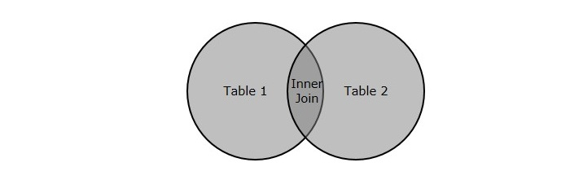
An SQL Join clause is used to combine multiple related tables in a database, based on common fields/columns.
There are two major types of joins: Inner Join and Outer Join. Other joins like Left Join, Right Join, Full Join etc. Are just subtypes of these two major joins. In this tutorial, we will only learn about the Inner Join.
The SQL Inner Join
The SQL Inner Join is a type of join that combines multiple tables by retrieving records that have matching values in both tables (in the common column).
It compares each row of the first table with each row of the second table, to find all pairs of rows that satisfy the join-predicate. When the join-predicate is satisfied, the column values from both tables are combined into a new table.

Slide 43
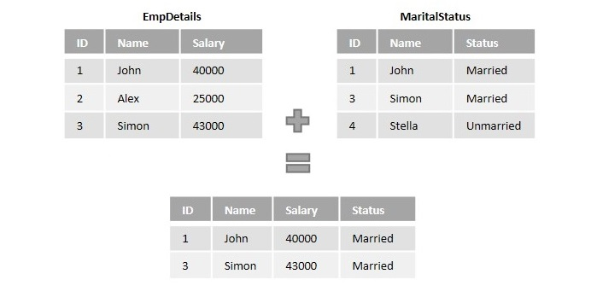
The Inner Join is also referred as Equijoin. It is the default join; i.e., even if the "Join"keyword is used instead of "Inner Join", tables are joined using matching records of common columns.
Explanation
Let us look at an example scenario to have a better understanding.
Suppose we have the information of employees in a company divided between two tables namely EmpDetails and Marital status. Where,
EmpDetails table holds details like Employee ID, Name and Salary.
MaritalStatus table holds the details Employee ID,Name and Marital Status.

Slide 44
What is Outer Join?
Outer Join is used to join multiple database tables into a combined result-set, that includes all the records, even if they don't satisfy the join condition. NULL values are displayed against these records where the join condition is not met.
This scenario only occurs if the left table (or the first table) has more records than the right table (or the second table), or vice versa.
There are three types of outer joins, namely −
Left (Outer) Join: Retrieves all the records from the first table, Matching records from the second table and NULL values in the unmatched rows.
Right (Outer) Join: Retrieves all the records from the second table, Matching records from the first table and NULL values in the unmatched rows.
Full (Outer) Join: Retrieves records from both the tables and fills the unmatched values with NULL.

Slide 45
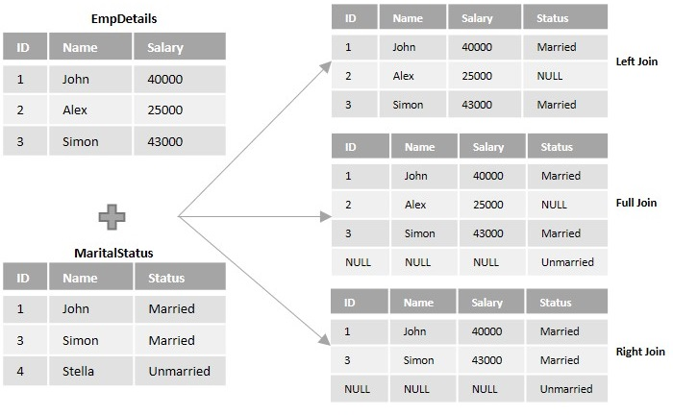

Slide 46

The SQL Left Join
Left Join or Left Outer Join in SQL combines two or more tables, where the first table is returned wholly; but, only the matching record(s) are retrieved from the consequent tables. If zero (0) records are matched in the consequent tables, the join will still return a row in the result, but with NULL in each column from the right table.
Left Join
If the number of rows in first table is less than the number of rows in second table, the rows in second table that do not have any counterparts in the first table will be discarded from the result.

Slide 47
SQL - Left Join
toggle
Joins are used to retrieve records from two or more tables based on a logical relation between them. This relation is defined using a join condition. As we discussed in the previous chapters, there are two types of Joins −
Inner Join
Outer Join
Left Join is a type of outer join that retrieves all the records from the first table and matches them to the records in second table. First of all, let us understand what is outer join.

Slide 48

SQL - Right Join
toggle
SQL Joins are used to retrieve records from multiple tables based on a given condition. A Join includes the records that satisfy the given condition and outer join results a table that contains both matched and unmatched rows.
Left Outer Join, as discussed in the previous tutorial, is used to find the union of two tables with respect to the left table. In this tutorial, let us discuss about the Right outer join.
The SQL Right Join
The Right Join or Right Outer Join query in SQL returns all rows from the right table, even if there are no matches in the left table. In short, a right join returns all the values from the right table, plus matched values from the left table or NULL in case of no matching join predicate.

Slide 49
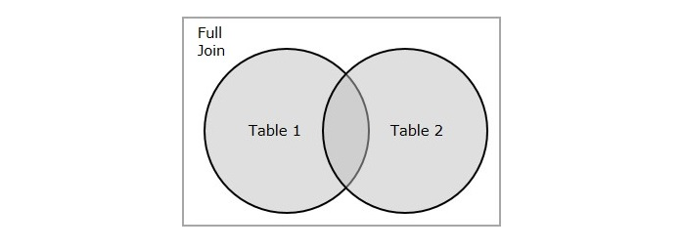
The SQL Full Join
SQL Full Join creates a new table by joining two tables as a whole. The joined table contains all records from both the tables and fills NULL values for missing matches on either side. In short, full join is a type of outer join that combines the result-sets of both left and right joins.
MySQL does not support Full Outer Join. Instead, you can imitate its working by performing union operation between the result-sets obtained from Left Join and Right Join.
Let us understand this concept in detail with the help of a Venn diagram below. Assume that we have two tables as two sets (represented by circles). The result-set (or newly joined table) obtained using full join is nothing but the union of these two sets.

Slide 50
You can also achieve the equivalent result-set of FULL JOIN by performing the UNION operation on result-sets of the LEFT JOIN and RIGHT JOIN.
Syntax
Following is the basic syntax of Full Join in SQL −
SELECT column_name(s)
FROM table1
FULL JOIN table2
ON table1.column_name = table2.column_name;
Full Join with WHERE Clause
Joins use the ON clause to filter records by default. Let us suppose there is a further requirement to filter these records based on a certain condition/constraint, we can also make use of the WHERE clause with Joins.
Syntax
The syntax of Full Join when used with WHERE clause is given below −

Slide 51
SELECT column_name(s)
FROM table1
FULL JOIN table2
ON table1.column_name = table2.column_name
WHERE condition;

Slide 52
SQL - NOT Operator
toggle
Most of the times, there is a need to use two or more conditions to filter required records from a table; but sometimes satisfying one of the conditions would be enough. There are also scenarios when you need to retrieve records that do not satisfy the conditions specified. SQL provides logical connectives for this purpose. They are listed below −
AND − Operator
OR − Operator
NOT − Operator
With the help of these logical connectives, one can retrieve records that are required and also create exceptions for the records that are not needed to be retrieved.

Slide 53
The SQL NOT Operator
SQL NOT is a logical operator/connective used to negate a condition or Boolean expression in a WHERE clause. That is, TRUE becomes FALSE and vice versa.
The most common scenario where this operator can be used occurs when there is a specification of what NOT to include in the result table, instead of what to include.
For instance, in an Indian voting system, people younger than 18 years of age are NOT allowed to vote. Therefore, while retrieving the information of all people who are eligible to vote, using the NOT operator, we can create an exception to minors since it is the only specification.
The NOT operator is always used in a WHERE clause so its scope within the clause is not always clear. Hence, a safer option to exactly execute the query is by enclosing the Boolean expression or a subquery by parentheses.

Slide 54
Syntax
Following is the syntax for SQL NOT operator −
NOT [CONDITION or BOOLEAN EXPRESSION];

Slide 55
The SQL NOT EQUAL Operator
The SQL NOT EQUAL operator is used to compare two values and return true if they are not equal. It is represented by "<>" and "!=". The difference between these two is that <> follows the ISO standard, but != doesn't. So, it is recommended to use the <> operator.
We can use the NOT EQUAL operator in WHERE clause to filter records based on a specific condition and in GROUP BY clause to group the results.
The comparison is case-sensitive by default, while using the NOT EQUAL operator with text values.
Syntax
Following is the syntax of the NOT EQUAL operator in SQL −
WHERE expression1 <> expression2;

Slide 56
NOT EQUAL with Text
We can use the NOT EQUAL operator with text in SQL to compare two text values and return. We can use "<>" or "!=" in the WHERE clause of a SQL statement and exclude rows that match a specific text value.
Example
In the following query, we are retrieving all the records from the CUSTOMERS table whose NAME is not 'Ramesh' −
SELECT * FROM CUSTOMERS WHERE NAME <> 'Ramesh';

Slide 57
NOT EQUAL with GROUP BY Clause
We can use the NOT EQUAL operator with the GROUP BY clause to group the results by the values that are not equal to the specified text value.
The aggregate functions such as COUNT(), MAX(), MIN(), SUM(), and AVG() are frequently used with the GROUP BY statement.
Example
Here, we are retrieving the number of records with distinct ages (excluding '22') in the 'CUSTOMERS' table and grouping them by age value −
SELECT COUNT(ID), AGE FROM CUSTOMERS
WHERE AGE <> '22' GROUP BY AGE;

Slide 58
NOT EQUAL with Multiple Conditions
The not equal operator can also be used with multiple conditions in a WHERE clause to filter out rows that match specific criteria.
Example
Now, we are retrieving all the customers whose salary is either ">2000" or "=2000". At the same time, the customer must not be from "Bhopal" −
SELECT * FROM CUSTOMERS
WHERE ADDRESS <> 'Bhopal' AND (SALARY>'2000' OR SALARY='2000');

Slide 59
SQL - IS NULL
toggle
Let's assume a table with NULL values in some of its fields. These fields indicate that no values are present in them. SQL allows users to create new records or modify existing ones without specifying a value for a field. If no value is provided, the field is stored with a NULL value.
In SQL, it is not possible to check NULL values with comparison operators such as =, <, or <>. Instead, we use the IS NULL and IS NOT NULL (negation of NULL values) operators.
The SQL IS NULL Operator
The SQL IS NULL operator is used to check whether a value in a column is NULL. It returns true if the column value is NULL; otherwise false.
The NULL is a value that represents missing or unknown data, and the IS NULL operator allows us to filter for records that contain NULL values in a particular column.
Syntax
Following is the syntax of IS NULL operator −
SELECT column_name1, column_name2, column_name3, ... , column_nameN
FROM table_name
WHERE column_nameN IS NULL;

Slide 60
SQL - IS NOT NULL
toggle
A NULL value indicates a missing or unknown value. It appears to be blank and does not contain any data. It is very important to understand that a NULL value is different than a zero value or a field that contains spaces. For checking null values we can use two basic operators.
IS NULL
IS NOT NULL
The SQL IS NOT NULL Operator
The SQL IS NOT NULL operator is used to filter data by verifying whether a particular column has a not-null values. This operator can be used with SQL statements such as SELECT, UPDATE, and DELETE.
By using the IS NOT NULL operator, we can only fetch the records that contain valid data in a particular column.
Syntax
Following is the syntax of the SQL IS NOT NULL operator −
SELECT column_names
FROM table_name
WHERE column_name IS NOT NULL;

Slide 61
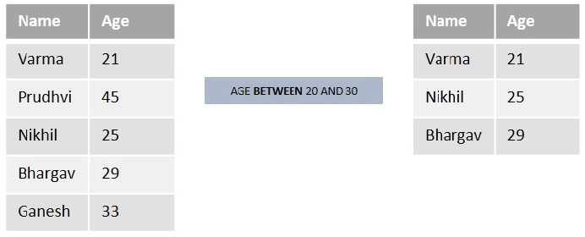
The SQL BETWEEN Operator
The BETWEEN operator is a logical operator in SQL, that is used to retrieve the data within a specified range. The retrieved values can be integers, characters, or dates.
You can use the BETWEEN operator to replace a combination of "greater than equal AND less than equal" conditions.
Let us understand it in a better way by using the below example table −

Slide 62
Suppose we want to list out the names from the above table who are aged BETWEEN 20 and 30. So, we will get "Varma(21)", "Nikhil(25)", and "Bhargav(29)" as a result.
Syntax
Following is the syntax of the BETWEEN operator in SQL −
SELECT column1, column2, column3,....columnN
FROM table_name
WHERE column BETWEEN value1 AND value2;
Here,
value1 is the beginning value of the range.
value2 is the ending value of the range (inclusive).
Example

Slide 63
BETWEEN Operator with IN Operator
In SQL, we can combine the BETWEEN operator with the IN operator to select values that are within a specified range and also matches with values specified in the list of IN clause.
Example
In the following query, we are retrieving the details of all the customers whose salary is between 4000 and 10000. In addition, we are only retrieving the customers who lives in Hyderabad and Bhopal using the IN operator in SQL −
SELECT * FROM CUSTOMERS
WHERE SALARY BETWEEN 4000 AND 10000
AND ADDRESS IN ('Hyderabad', 'Bhopal');
Output

Slide 64
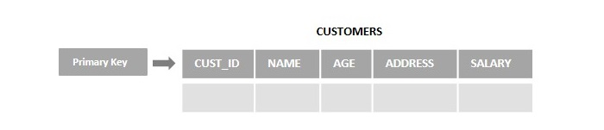
The SQL Primary Key
The SQL Primary Key is a column (or combination of columns) that uniquely identifies each record in a database table. The Primary Key also speeds up data access and is used to establish a relationship between tables.
Even though a table can only have one Primary Key, it can be defined on one or more fields. When a primary key is created on multiple fields of a table, it is called a Composite Key.
Let us say, you are developing an application called "Customer Management System" to handle all the customer data of a member-only resort. This data can include their personal details, assigned member IDs, other details of the membership they opted, etc. And in all the tables created within this database, the member ID is used to distinguish the customers from each other. So, this field will be the Primary Key.
Following is the diagram of a CUSTOMERS table that holds the personal details of the customers. And as we can observe, the primary key is defined on the CUST_ID column. Using this primary key, we can retrieve a unique record of any customer.

Slide 65
Points to Remember
Here are some key points of the PRIMARY KEY −
It contains only a unique value.
It can not be null.
One table can have only one Primary Key.
A primary key length cannot be more than 900 bytes.
Creating an SQL Primary Key
While creating a table using the CREATE TABLE statement, you can add the primary key constraint on a particular column of the table just by to specifying the name of the column along with the keyword "PRIMARY KEY".
Syntax
Following is the syntax to define a column of a table as a primary key −

Slide 66
CREATE TABLE table_name(
column1 datatype,
column2 datatype,
column3 datatype,
.....
columnN datatype,
PRIMARY KEY(column_name)
);

Slide 67
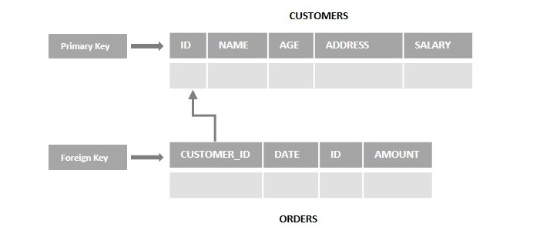
The SQL Foreign Key
In SQL, a Foreign Key is a column in one table that matches a Primary Key in another table, allowing the two tables to be connected together.
A foreign key also maintains referential integrity between two tables, making it impossible to drop the table containing the primary key (preserving the connection between the tables).
The foreign key can reference the unique fields of any table in the database. The table that has the primary key is known as the parent table and the key with the foreign key is known as the child table.
Let's consider an example scenario, assume we have two tables namely CUSTOMERS (ID, NAME, AGE, ADDRES, SALARY) and ORDERS (ID, DATE, CUSTOMER_ID, AMOUNT). Here the id of the customer is primary key (ID) in the CUSTOMERS table and foreign key in the ORDERS (CUSTOMER_ID) table observe the following diagram −

Slide 68
Features of Foreign Key
Following is the of features of Foreign Key −
A Foreign Key is used to reduce the redundancy (or duplicates) in the table.
It helps to normalize (or organize the data in a database) the data in multiple tables.
Syntax
Following is the basic syntax to add Foreign Key constraints on a column of a table in MySQL database −
CREATE TABLE table_name (
column1 datatype,
column2 datatype,
...
CONSTRAINT fk_name
FOREIGN KEY (column_name)
REFERENCES referenced_table(referenced_column)
);

Slide 69
CREATE TABLE ORDERS (
ID INT NOT NULL,
DATE DATETIME,
CUSTOMER_ID INT,
CONSTRAINT FK_CUSTOMER
FOREIGN KEY(CUSTOMER_ID)
REFERENCES CUSTOMERS(ID),
AMOUNT DECIMAL,
PRIMARY KEY (ID)
);

